Slide 1
Friday, October 26, 2012
No TISK problems or Mental Math Today
Homework: p. 226 #36-39 all

Slide 2
§4-6 Analyzing Isosceles Triangles
Isosceles Triangle Theorem
If two sides of a triangle are congruent, then the angles opposite those sides are congruent.
If

Slide 3
§4-6 Analyzing Isosceles Triangles
Converse of the Isosceles Triangle Theorem
If two angles of a triangle are congruent, then the sides opposite those angles are congruent.
If

Slide 4
§4-6 Analyzing Isosceles Triangles
Corollary
A triangle is equilateral if and only if it is equiangular.

Slide 5
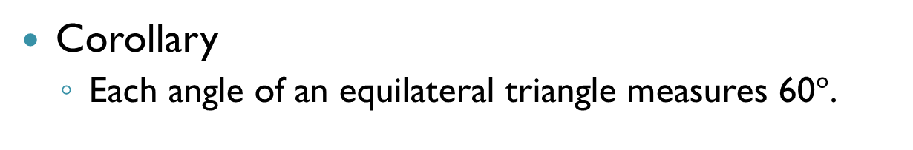
§4-6 Analyzing Isosceles Triangles
Corollary
Each angle of an equilateral triangle measures 60$°$.

Slide 6
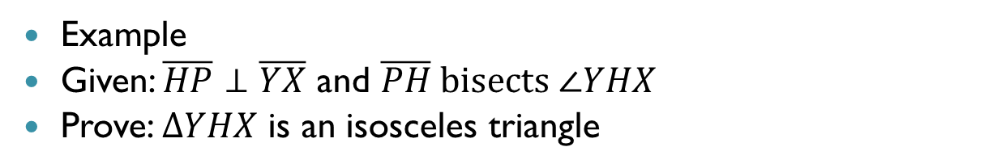
§4-6 Analyzing Isosceles Triangles
Example
Given: $\overline{HP}⊥\overline{YX}$ and $\overline{PH} bisects ∠YHX$
Prove: $∆YHX$ is an isosceles triangle
Y
H
P
X

Slide 7
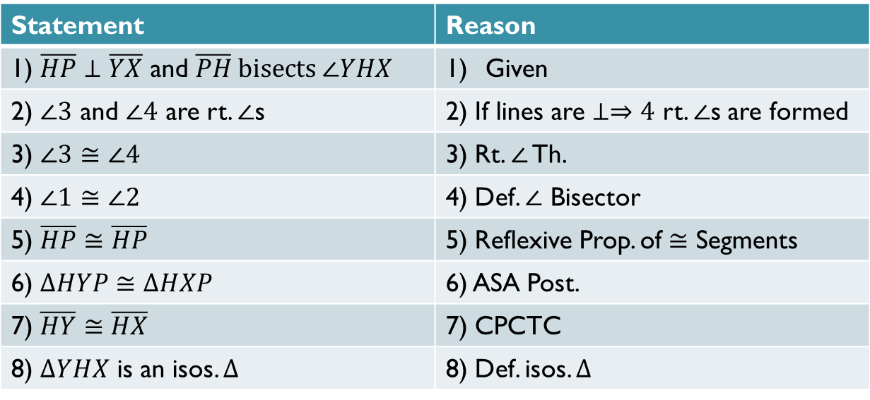
Proof
Statement | Reason
1) $\overline{HP}⊥\overline{YX}$ and $\overline{PH} bisects ∠YHX$ | Given
2) $∠3$ and $∠4$ are rt. $∠$s | 2) If lines are $⊥⇒4$ rt. $∠$s are formed
3) $∠3$ $≅∠4$ | 3) Rt. $∠$ Th.
4) $∠1$ $≅∠2$ | 4) Def. $∠$ Bisector
5) $\overline{HP}≅\overline{HP}$ | 5) Reflexive Prop. of $≅$ Segments
6) $∆HYP≅∆HXP$ | 6) ASA Post.
7) $\overline{HY}≅\overline{HX}$ | 7) CPCTC
8) $∆YHX$ is an isos. $∆$ | 8) Def. isos. $∆$

Slide 8
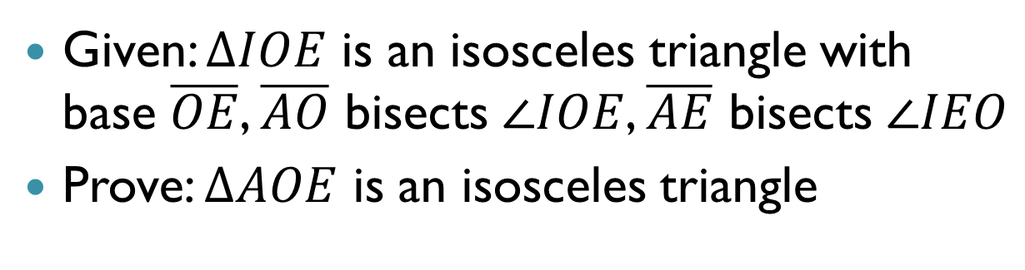
§4-6 Analyzing Isosceles Triangles
Given: $∆IOE$ is an isosceles triangle with base $\overline{OE}$, $\overline{AO}$ bisects $∠IOE$, $\overline{AE}$ bisects $∠IEO$
Prove: $∆AOE$ is an isosceles triangle
I
A
3
1
4
2
E
O

Slide 9
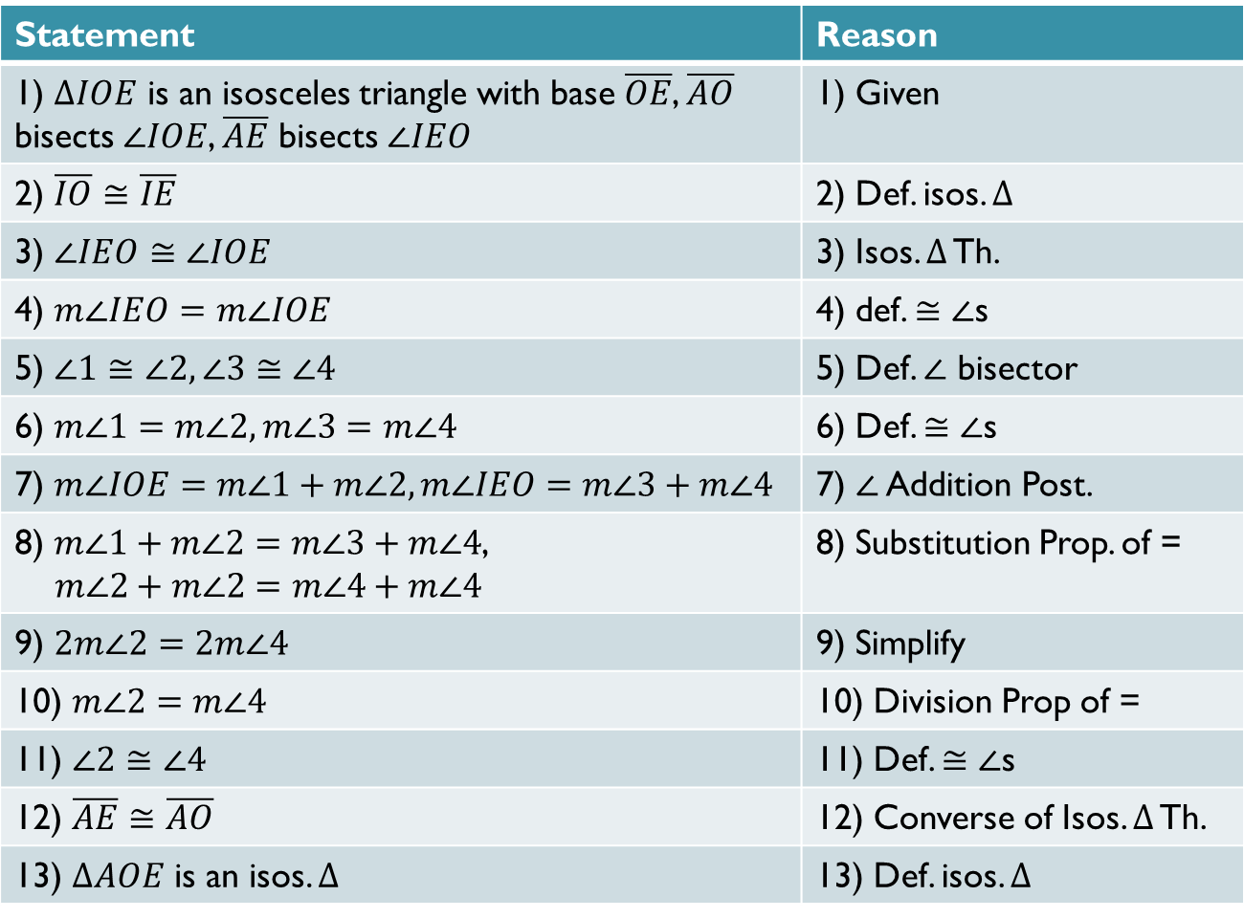
Proof
Statement | Reason
1) $∆IOE$ is an isosceles triangle with base $\overline{OE}$, $\overline{AO}$ bisects $∠IOE$, $\overline{AE}$ bisects $∠IEO$ | 1) Given
2) $\overline{IO}≅\overline{IE}$ | 2) Def. isos. $∆$
3) $∠IEO≅∠IOE$ | 3) Isos. $Δ$ Th.
4) $m∠IEO=m∠IOE$ | 4) def. $≅∠$s
5) $∠1≅∠2, ∠3≅∠4$ | 5) Def. $∠$ bisector
6) $m∠1=m∠2, m∠3=m∠4$ | 6) Def. $≅∠$s
7) $m∠IOE=m∠1+m∠2, m∠IEO=m∠3+m∠4$ | 7) $∠$ Addition Post.
8) $m∠1+m∠2=m∠3+m∠4$, $m∠2+m∠2=m∠4+m∠4$ | 8) Substitution Prop. of =
9) $2m∠2=2m∠4$ | 9) Simplify
10) $m∠2=m∠4$ | 10) Division Prop of =
11) $∠2≅∠4$ | 11) Def. $≅∠$s
12) $\overline{AE}≅\overline{AO}$ | 12) Converse of Isos. $Δ$ Th.
13) $ΔAOE$ is an isos. $Δ$ | 13) Def. isos. $∆$

